Slide 1
SQL

Slide 2
COMPANY Database- ER DIAGRAM
name
number
location
fname
lname
1
minit
works for
N
department
address
salary
name
sex
1
number of
employees
startdate
1
ssn
employee
manages
controls
bdate
1
supervisor
N
hours
N
degree
supervisee
supervision
1
works on
M
project
dependents of
name
number
location
N
dependent
name
sex
birthdate
relationship
Slide 8-<number>

Slide 3

COMPANY Database- ER DIAGRAM to SCHEMA
Slide 8-<number>

Slide 4

COMPANY Database state
Slide 8-<number>

Slide 5
SQL- Structured Query Language
Is a computer language for storing, manipulating and retrieving data stored in a relational database
First commercial language introduced for E.F Codd’s Relational Model
Slide 8-<number>

Slide 6
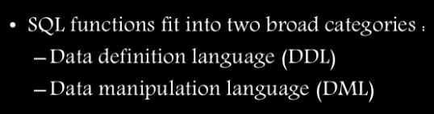
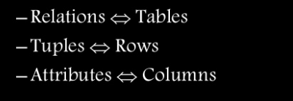
Slide 8-<number>

Slide 7
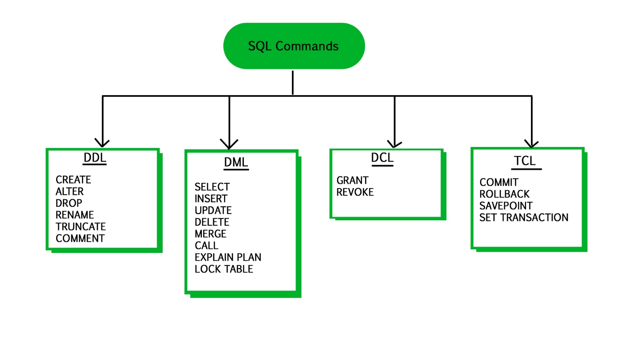
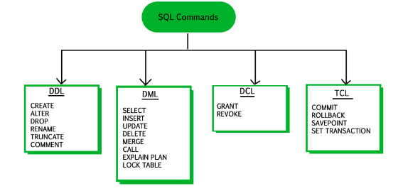
Slide 8-<number>

Slide 8
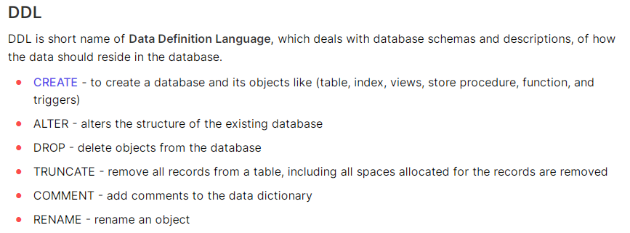
Slide 8-<number>

Slide 9
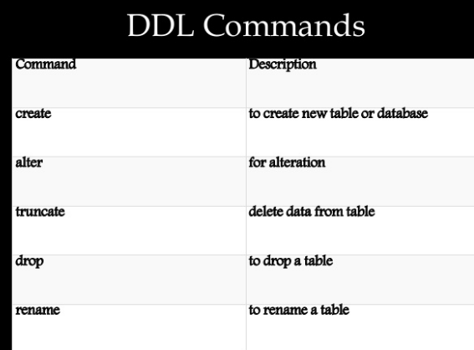
Slide 8-<number>

Slide 10
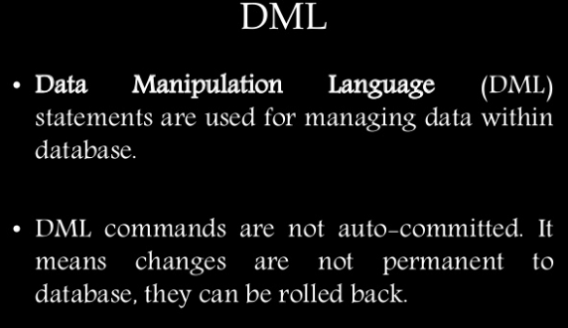
Slide 8-<number>

Slide 11
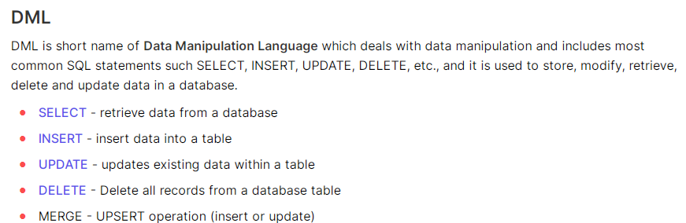
Slide 8-<number>

Slide 12
Data Definition, Constraints, and Schema Changes
Used to CREATE, DROP, and ALTER the descriptions of the tables (relations) of a database
Slide 8-<number>

Slide 13

Create table
SQL CREATE TABLE Syntax
CREATE TABLE table_name
(
column_name1 data_type(size),
column_name2 data_type(size),
column_name3 data_type(size),
....
);
CREATE TABLE Persons
(
PersonID int,
LastName varchar(255),
FirstName varchar(255),
Address varchar(255),
City varchar(255)
);
Slide 8-<number>

Slide 14
CREATE TABLE
Specifies a new base relation by giving it a name, and specifying each of its attributes and their data types (INTEGER, FLOAT, DECIMAL(i,j), CHAR(n), VARCHAR(n))
A constraint NOT NULL may be specified on an attribute
CREATE TABLE DEPARTMENT
( DNAME VARCHAR(10) NOT NULL,
DNUMBER INTEGER NOT NULL,
MGRSSN CHAR(9),
MGRSTARTDATE CHAR(9) );
Slide 8-<number>

Slide 15
CREATE TABLE
In SQL2, can use the CREATE TABLE command for specifying the primary key attributes, secondary keys, and referential integrity constraints (foreign keys).
Key attributes can be specified via the PRIMARY KEY and UNIQUE phrases
  CREATE TABLE Dept
  ( Dname VARCHAR(10) NOT NULL,
  Dnum INTEGER NOT NULL,
  Mgrssn CHAR(9),
  Mgrstartdate CHAR(9),
  PRIMARY KEY (Dnum),
  UNIQUE (Dname),
  FOREIGN KEY (Mgrssn) REFERENCES Emp );
Slide 8-<number>

Slide 16
SQL Constraints
SQL constraints are used to specify rules for the data in a table.
The following constraints are commonly used in SQL:
NOT NULL - Ensures that a column cannot have a NULL value
PRIMARY KEY - A combination of a NOT NULL and UNIQUE. Uniquely identifies each row in a table
FOREIGN KEY - Prevents actions that would destroy links between tables
CHECK - Ensures that the values in a column satisfies a specific condition
DEFAULT - Sets a default value for a column if no value is specified
UNIQUE - Ensures that all values in a column are different
Slide 8-<number>

Slide 17
REFERENTIAL INTEGRITY OPTIONS
We can specify RESTRICT, CASCADE, SET NULL or SET DEFAULT on referential integrity constraints (foreign keys)
CREATE TABLE DEPT
( DNAME VARCHAR(10) NOT NULL,
DNUMBER INTEGER NOT NULL,
MGRSSN CHAR(9),
MGRSTARTDATE CHAR(9),
PRIMARY KEY (DNUMBER),
UNIQUE (DNAME),
FOREIGN KEY (MGRSSN) REFERENCES EMP
ON DELETE CASCADE );
DELETE CASCADE : We use ON DELETE cascade when we want that all referenced entities will automatically delete if we delete any parent entity.
Slide 8-<number>

Slide 18
REFERENTIAL INTEGRITY OPTIONS
We can specify RESTRICT, CASCADE, SET NULL or SET DEFAULT on referential integrity constraints (foreign keys)
CREATE TABLE DEPT
( DNAME VARCHAR(10) NOT NULL,
DNUMBER INTEGER NOT NULL,
MGRSSN CHAR(9),
MGRSTARTDATE CHAR(9),
PRIMARY KEY (DNUMBER),
UNIQUE (DNAME),
FOREIGN KEY (MGRSSN) REFERENCES EMP
ON UPDATE CASCADE );
UPDATE CASCADE : This is the same as ON DELETE cascade. The difference is that instead of delete referenced table data it will update the data.
Slide 8-<number>

Slide 19
ON DELETE CASCADE
    It specifies that the child data is deleted when the parent data is deleted.
ON UPDATE
    Optional. It specifies what to do with the child data when the parent data is updated. You have the options of NO ACTION, CASCADE, SET NULL, or SET DEFAULT.
Slide 8-<number>

Slide 20
REFERENTIAL INTEGRITY OPTIONS
We can specify RESTRICT, CASCADE, SET NULL or SET DEFAULT on referential integrity constraints (foreign keys)
CREATE TABLE DEPT
( DNAME VARCHAR(10) NOT NULL,
DNUMBER INTEGER NOT NULL,
MGRSSN CHAR(9),
MGRSTARTDATE CHAR(9),
PRIMARY KEY (DNUMBER),
UNIQUE (DNAME),
FOREIGN KEY (MGRSSN) REFERENCES EMP
ON DELETE SET DEFAULT ON UPDATE CASCADE );
Slide 8-<number>

Slide 21
REFERENTIAL INTEGRITY OPTIONS (continued)
  CREATE TABLE EMP
  ( ENAME VARCHAR(30) NOT NULL,
  ESSN CHAR(9),
  BDATE DATE,
  DNO INTEGER DEFAULT 1,
  SUPERSSN CHAR(9),
  PRIMARY KEY (ESSN),
  FOREIGN KEY (DNO) REFERENCES DEPT
  ON DELETE SET DEFAULT ON UPDATE CASCADE,
  FOREIGN KEY (SUPERSSN) REFERENCES EMP
  ON DELETE SET NULL ON UPDATE CASCADE );
Slide 8-<number>

Slide 22

DROP TABLE
Used to remove a relation (base table) and its definition
The relation can no longer be used in queries, updates, or any other commands since its description no longer exists
Example:
DROP TABLE DEPENDENT;
DROP TABLE table_name
Slide 8-<number>

Slide 23
ALTER TABLE
Used to add an attribute to one of the base relations
The new attribute will have NULLs in all the tuples of the relation right after the command is executed; hence, the NOT NULL constraint is not allowed for such an attribute
Example:
ALTER TABLE EMPLOYEE ADD JOB VARCHAR(12);
The database users must still enter a value for the new attribute JOB for each EMPLOYEE tuple. This can be done using the UPDATE command.
Slide 8-<number>

Slide 24




ALTER TABLE
To add a column in a table :
To delete a column in a table
Example
Syntax
ALTER TABLE table_name
ADD column_name datatype
ALTER TABLE Persons
ADD email varchar(20);
ALTER TABLE table_name
DROP column_name
ALTER TABLE Persons
DROP column email;
Slide 8-<number>

Slide 25


To create a PRIMARY KEY constraint on the "ID" column when the table is already created
To drop a PRIMARY KEY constraint,
ALTER TABLE Persons
ADD PRIMARY KEY (ID);
ALTER TABLE Persons
DROP PRIMARY KEY;
Slide 8-<number>

Slide 26
Additional Data Types in SQL2 and SQL-99
Has DATE, TIME, and TIMESTAMP data types
DATE:
  Made up of year-month-day in the format yyyy-mm-dd
TIME:
  Made up of hour:minute:second in the format hh:mm:ss
TIME(i):
  Made up of hour:minute:second plus i additional digits specifying fractions of a second
  format is hh:mm:ss:ii...i
TIMESTAMP:
  Has both DATE and TIME components
Slide 8-<number>

Slide 27
Additional Data Types in SQL2 and SQL-99 (cont.)
INTERVAL:
  Specifies a relative value rather than an absolute value
  Can be DAY/TIME intervals or YEAR/MONTH intervals
  Can be positive or negative when added to or subtracted from an absolute value, the result is an absolute value
  query
  Result: 2017-06-15 09:49:21
SELECT DATE_ADD("2017-06-15 09:34:21", INTERVAL 15 MINUTE);
Slide 8-<number>

Slide 28
Specifying Updates in SQL
There are three SQL commands to modify the database; INSERT, DELETE, and UPDATE
Slide 8-<number>

Slide 29
INSERT
In its simplest form, it is used to add one or more tuples to a relation
Attribute values should be listed in the same order as the attributes were specified in the CREATE TABLE command
Slide 8-<number>

Slide 30
INSERT (cont.)
Example:
U1: INSERT INTO EMPLOYEE
VALUES ('Richard','K','Marini', '653298653', '30-DEC-52',
'98 Oak Forest,Katy,TX', 'M', 37000,'987654321', 4 )
An alternate form of INSERT specifies explicitly the attribute names that correspond to the values in the new tuple
Attributes with NULL values can be left out
Example: Insert a tuple for a new EMPLOYEE for whom we only know the FNAME, LNAME, and SSN attributes.
U1A: INSERT INTO EMPLOYEE (FNAME, LNAME, SSN)
VALUES ('Richard', 'Marini', '653298653')
Slide 8-<number>

Slide 31
Retrieval Queries in SQL
SQL has one basic statement for retrieving information from a database; the SELECT statement
This is not the same as the SELECT operation of the relational algebra
Important distinction between SQL and the formal relational model; SQL allows a table (relation) to have two or more tuples that are identical in all their attribute values
Hence, an SQL relation (table) is a multi-set (sometimes called a bag) of tuples; it is not a set of tuples
SQL relations can be constrained to be sets by specifying PRIMARY KEY or UNIQUE attributes, or by using the DISTINCT option in a query
Slide 8-<number>

Slide 32
Retrieval Queries in SQL (cont.)
Basic form of the SQL SELECT statement is called a mapping or a SELECT-FROM-WHERE block
  SELECT <attribute list>
  FROM <table list>
  WHERE <condition>
  <attribute list> is a list of attribute names whose values are to be retrieved by the query
  <table list> is a list of the relation names required to process the query
  <condition> is a conditional (Boolean) expression that identifies the tuples to be retrieved by the query
Slide 8-<number>

Slide 33
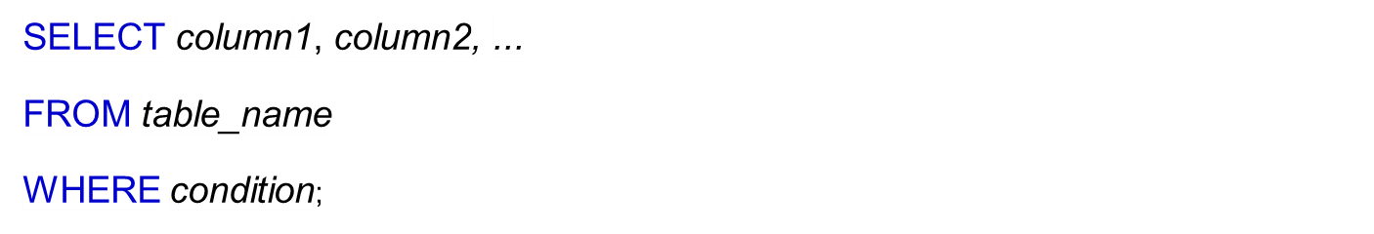


SQL WHERE CLAUSE

Slide 34
OPERATORS IN THE WHERE CLAUSE
Operator | Description
= | EQUAL
> | GREATER THAN
< | LESS THAN
>= | GREATER THAN OR EQUAL
<= | LESS THAN OR EQUAL
<> | NOT EQUAL
BETWEEN | BETWEEN A RANGE
LIKE | SEARCH FOR A PATTERN
IN | TO SPECIFY MULTIPLE POSSIBLE VALUES FROM A COLUMN

Slide 35


CONNECTORS- AND , OR, NOT

Slide 36


CONNECTORS- AND , OR, NOT

Slide 37


CONNECTORS- AND , OR, NOT

Slide 38
Simple SQL Query
Product
PName | Price | Category | Manufacturer
Gizmo | $19.99 | Gadgets | GizmoWorks
Powergizmo | $29.99 | Gadgets | GizmoWorks
SingleTouch | $149.99 | Photography | Canon
MultiTouch | $203.99 | Household | Hitachi
SELECT *
FROM Product
WHERE category=‘Gadgets’
PName | Price | Category | Manufacturer
Gizmo | $19.99 | Gadgets | GizmoWorks
Powergizmo | $29.99 | Gadgets | GizmoWorks
“selection”

Slide 39
Simple SQL Query
Product
PName | Price | Category | Manufacturer
Gizmo | $19.99 | Gadgets | GizmoWorks
Powergizmo | $29.99 | Gadgets | GizmoWorks
SingleTouch | $149.99 | Photography | Canon
MultiTouch | $203.99 | Household | Hitachi
SELECT PName, Price, Manufacturer
FROM Product
WHERE Price > 100
“selection” and
“projection”
PName | Price | Manufacturer
SingleTouch | $149.99 | Canon
MultiTouch | $203.99 | Hitachi

Slide 40

Relational Database Schema--Figure 5.5
Slide 8-<number>

Slide 41

Populated Database--Fig.5.6
Slide 8-<number>

Slide 42
Simple SQL Queries
Basic SQL queries correspond to using the SELECT, PROJECT, and JOIN operations of the relational algebra
All subsequent examples use the COMPANY database
Example of a simple query on one relation
Query 0: Retrieve the birthdate and address of the employee whose name is 'John B. Smith'.
  Q0: SELECT BDATE, ADDRESS
  FROM EMPLOYEE
  WHERE FNAME='John' AND MINIT='B’
  AND LNAME='Smith’
  Similar to a SELECT-PROJECT pair of relational algebra operations; the SELECT-clause specifies the projection attributes and the WHERE-clause specifies the selection condition
  However, the result of the query may contain duplicate tuples
Slide 8-<number>

Slide 43
Simple SQL Queries (cont.)
Query 1: Retrieve the name and address of all employees who work for the 'Research' department.
  Q1: SELECT FNAME, LNAME, ADDRESS
  FROM EMPLOYEE, DEPARTMENT
  WHERE DNAME='Research' AND DNUMBER=DNO
  Similar to a SELECT-PROJECT-JOIN sequence of relational algebra operations
  (DNAME='Research') is a selection condition (corresponds to a SELECT operation in relational algebra)
  (DNUMBER=DNO) is a join condition (corresponds to a JOIN operation in relational algebra)
Slide 8-<number>

Slide 44
Simple SQL Queries (cont.)
Query 2: For every project located in 'Stafford', list the project number, the controlling department number, and the department manager's last name, address, and birthdate.
  Q2: SELECT PNUMBER, DNUM, LNAME, BDATE, ADDRESS
  FROM PROJECT, DEPARTMENT, EMPLOYEE
  WHERE DNUM=DNUMBER AND MGRSSN=SSN AND PLOCATION='Stafford'
  In Q2, there are two join conditions
  The join condition DNUM=DNUMBER relates a project to its controlling department
  The join condition MGRSSN=SSN relates the controlling department to the employee who manages that department
Slide 8-<number>

Slide 45
UPDATE
Used to modify attribute values of one or more selected tuples
A WHERE-clause selects the tuples to be modified
An additional SET-clause specifies the attributes to be modified and their new values
Each command modifies tuples in the same relation
Referential integrity should be enforced
Slide 8-<number>

Slide 46
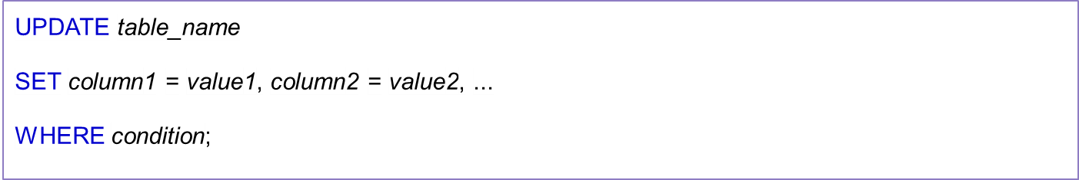


SQL UPDATE

Slide 47
DELETE
Removes tuples from a relation
Includes a WHERE-clause to select the tuples to be deleted
Tuples are deleted from only one table at a time (unless CASCADE is specified on a referential integrity constraint)
A missing WHERE-clause specifies that all tuples in the relation are to be deleted; the table then becomes an empty table
The number of tuples deleted depends on the number of tuples in the relation that satisfy the WHERE-clause
Referential integrity should be enforced
Slide 8-<number>

Slide 48


SQL DELETE

Slide 49
DELETE (cont.)
Examples:
U4A: DELETE FROM EMPLOYEE
WHERE LNAME='Brown’
U4B: DELETE FROM EMPLOYEE
WHERE SSN='123456789’
U4C: DELETE FROM EMPLOYEE
WHERE DNO IN (SELECT DNUMBER
FROM DEPARTMENT
WHERE DNAME='Research')
U4D: DELETE FROM EMPLOYEE
Slide 8-<number>

Slide 50
Aliases
Aliases are used to temporarily rename a table name or a column name
For Table
Select P.dno, E.dno
from Project as P, Employee as E
where P.dno=E.dno;
SELECT column name
FROM table1 AS alias_name,table2 AS alias_name
WHERE condition1;
Slide 8-<number>

Slide 51
Aliases contin..
For Column
Select dno AS project_number
from Project ;
SELECT column name AS alias_name
FROM table;
Slide 8-<number>

Slide 52
AGGREGATE FUNCTIONS
Include COUNT, SUM, MAX, MIN, and AVG
Slide 8-<number>

Slide 53
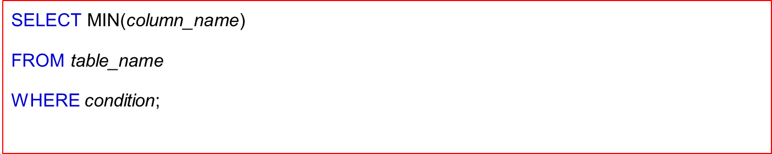


SQL MIN( )

Slide 54
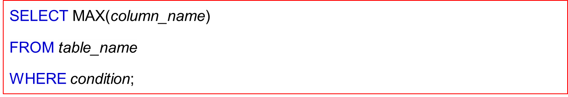

SQL MAX( )

Slide 55


SQL COUNT( )

Slide 56
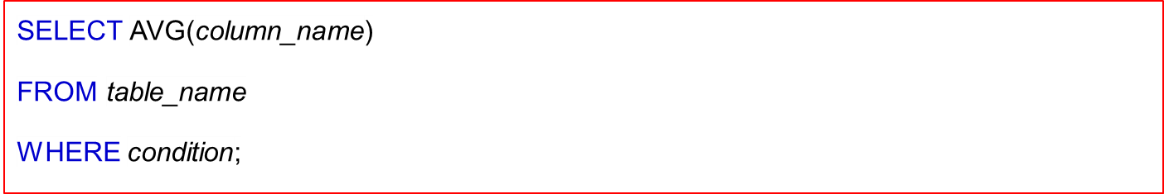

SQL AVG( )

Slide 57


SQL SUM( )

Slide 58
Aggregate example
Query 15: Find the maximum salary, the minimum salary, and the average salary among all employees.
Q15: SELECT MAX(SALARY), MIN(SALARY), AVG(SALARY)
FROM EMPLOYEE
  Some SQL implementations may not allow more than one function in the SELECT-clause
Slide 8-<number>

Slide 59
SUBSTRING COMPARISON
The LIKE comparison operator is used to compare partial strings
Two reserved characters are used: '%' (or '*' in some implementations) replaces an arbitrary number of characters, and '_' replaces a single arbitrary character
Slide 8-<number>

Slide 60

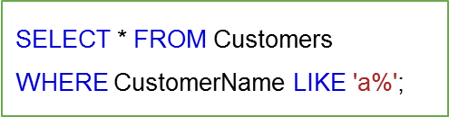
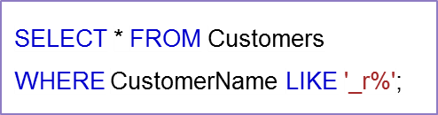
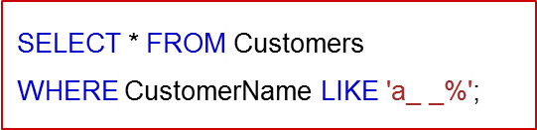

SQL LIKE OPERATOR

Slide 61
SUBSTRING COMPARISON (cont.)
Query 25: Retrieve all employees whose address is in Houston, Texas. Here, the value of the ADDRESS attribute must contain the substring 'Houston,TX'.
Q25: SELECT FNAME, LNAME
FROM EMPLOYEE
WHERE ADDRESS LIKE '%Houston,TX%’
Slide 8-<number>

Slide 62


SQL DISTINCT

Slide 63
USE OF *
To retrieve all the attribute values of the selected tuples, a * is used, which stands for all the attributes
Examples:
Q1C: SELECT *
FROM EMPLOYEE
WHERE DNO=5
Q1D: SELECT *
FROM EMPLOYEE, DEPARTMENT
WHERE DNAME='Research' AND DNO=DNUMBER
Slide 8-<number>

Slide 64
ORDER BY
The ORDER BY clause is used to sort the tuples in a query result based on the values of some attribute(s)
SELECT * FROM DEPARTMENT ORDER BY DNAME ; [sort in ascending order by default]
SELECT * FROM DEPARTMENT ORDER BY DNAME ASC ; [sort in ascending order using ASC]
SELECT * FROM DEPARTMENT ORDER BY DNAME DESC ; [sort in ascending order using desc]
Slide 8-<number>

Slide 65
ORDER BY (cont.)
The default order is in ascending order of values
We can specify the keyword DESC if we want a descending order; the keyword ASC can be used to explicitly specify ascending order, even though it is the default
Slide 8-<number>

